Slide 1

Transportation Planning Nashville, TN
Scooter Snatchers
Notes:
Intro – Robert L.

Slide 2
Agenda
Keep Companies making Profits
Discourage Piling of Scooters
Transportation Goals
Notes:
Agenda – Robert L.

Slide 3

Keep Companies Making Profits
How does Metro Nashville keep Micromobility Profitable in 2021?
Notes:
Introduce section and Jackie D.

Slide 4
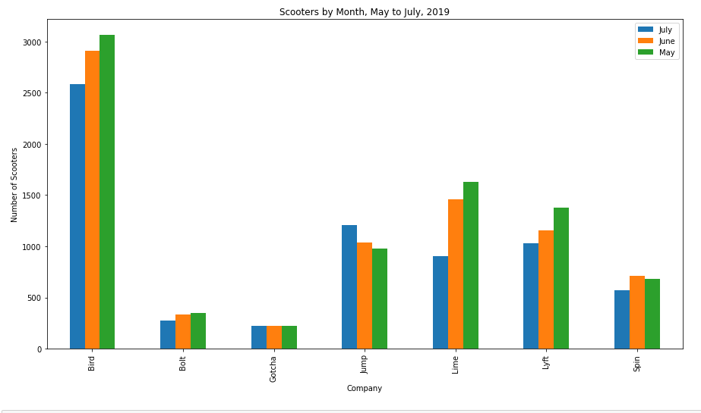
Notes:
Jackie D

Slide 5
Keep Companies Making Profits
Work with companies that have lower percentages of Scooters
Rethink about what scooter companies to contract with
Ads for scooters or “Grand Opening”
Initiative for more sidewalks around Nashville include rebranding of “Scooter Etiquette”
Standardize reporting data for scalability
Standardize logging for pings, charging, and trips
Bus pass gives discounts for scooter riders
Incentives for lesser known companies to be last mile solutions
Have Scooter Juicers redistribute scooters in Promise Zone
Notes:
Jackie D

Slide 6
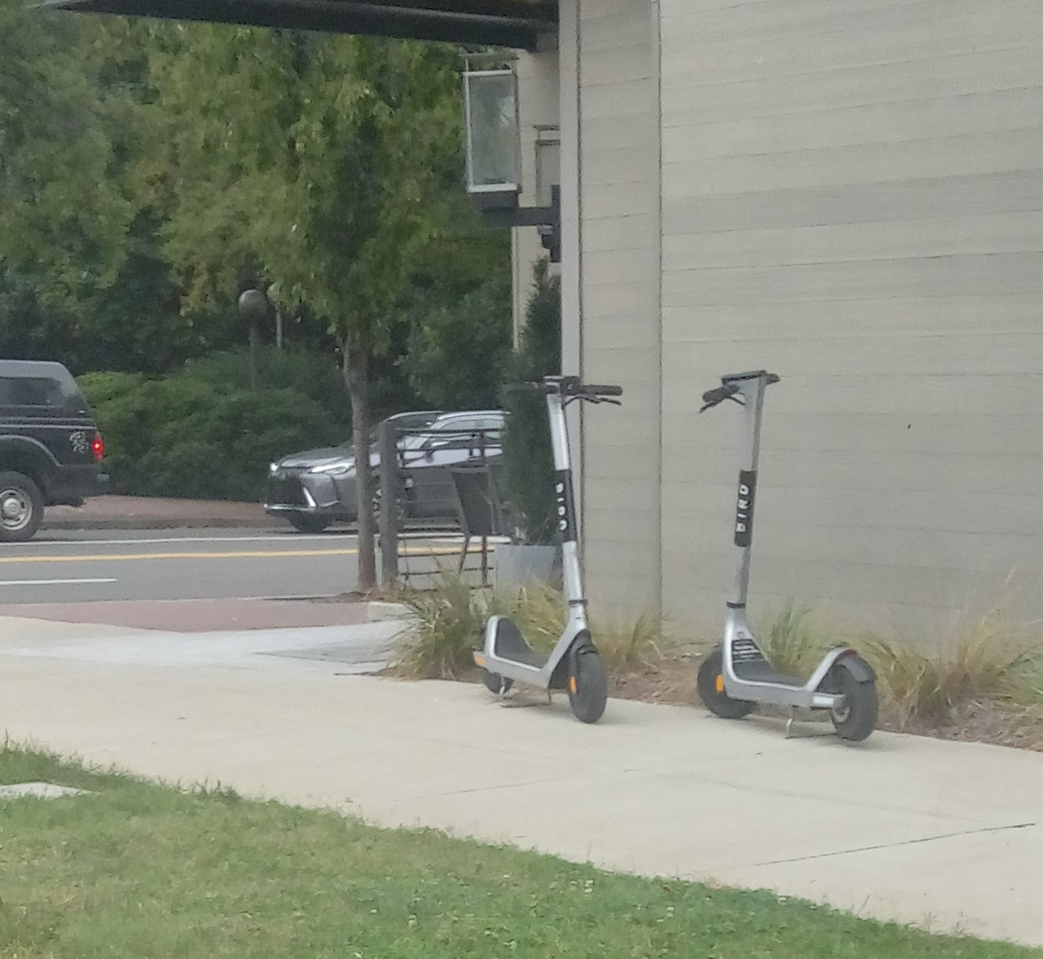
Scooter Piling Challenge
Discouraging the piling of Scooters
Notes:
Introduce section and Michael

Slide 7
Discourage Piling of Scooters
Incentive for parking scooter in a certain area
Discount on next ride
Discount on existing ride
Deadzone
Signage to warn scooter riders of approaching deadzones
Where to place scooters inside the deadzone (scooter parking)
Vocalize countdown warning of deadzone
Work with Scooter Parking Companies to assist with charging and parking of scooters
Swiftmile
Notes:
Michael F

Slide 8
Rogue Scooters!
Notes:
Micheal

Slide 9
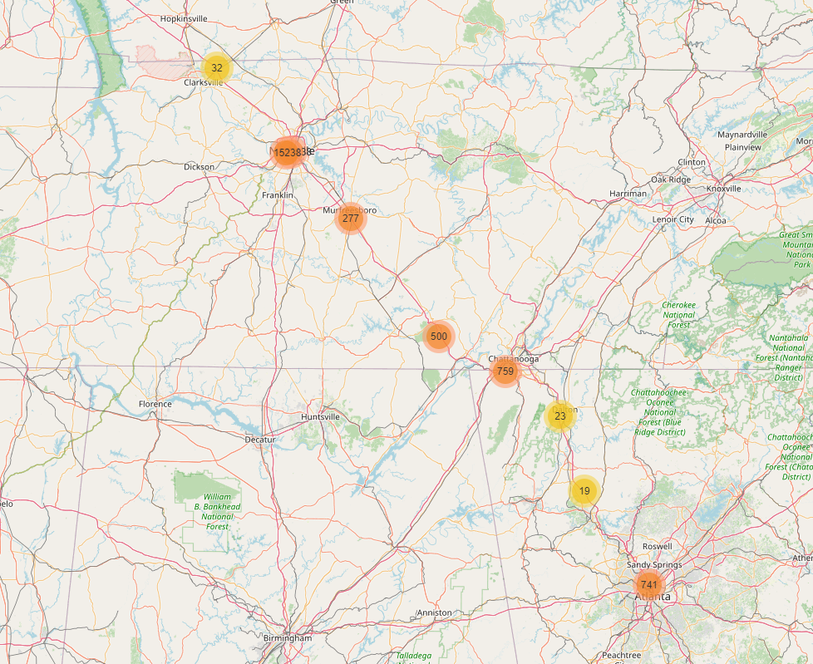
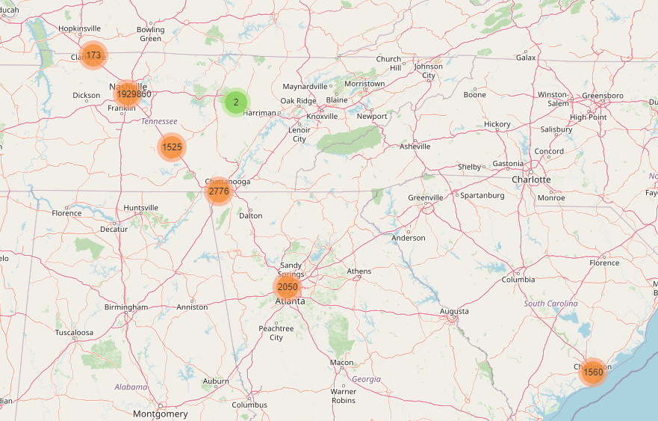
Believe it or Not!
Notes:
Michael

Slide 10
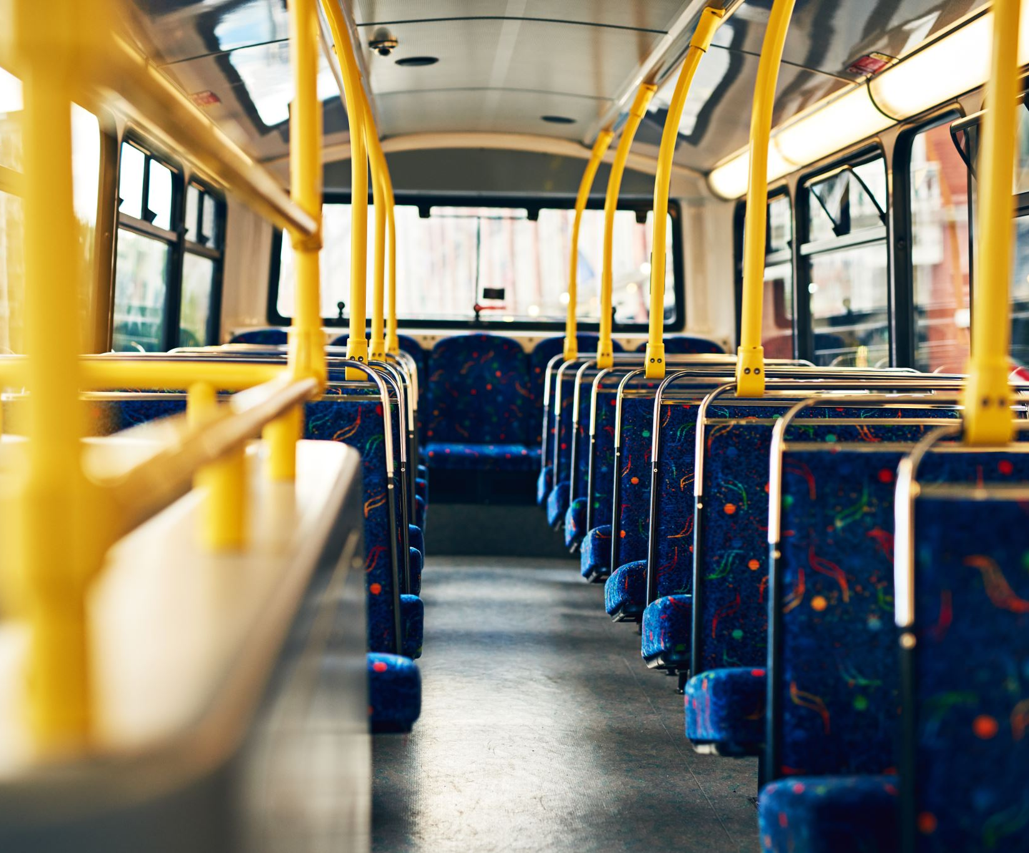
Transportation Goals
Reduce Single Drivers
Mitigate Last Mile
Three by Three
Notes:
Introduce section and Liu & Taryn

Slide 11
Reduce Single Drivers by SUMD
Scooter Riding times
Notes:
Liu

Slide 12
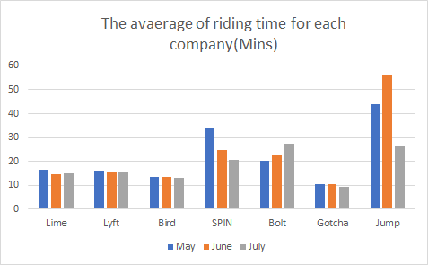
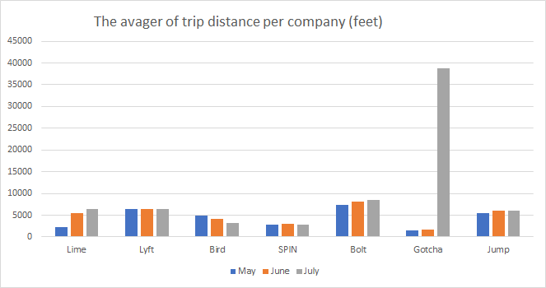
Reduce Single Drivers by SUMD
Notes:
Liu

Slide 13
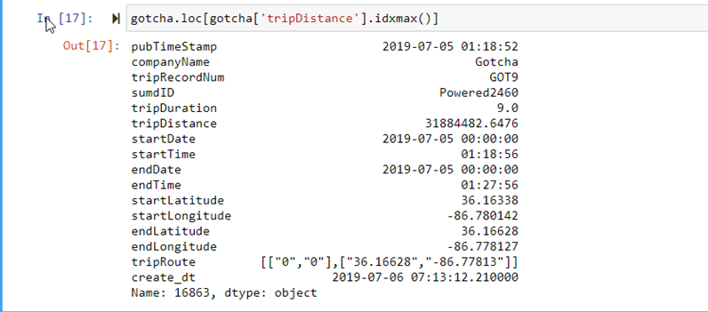
Reduce Single Drivers by SUMD

Slide 14
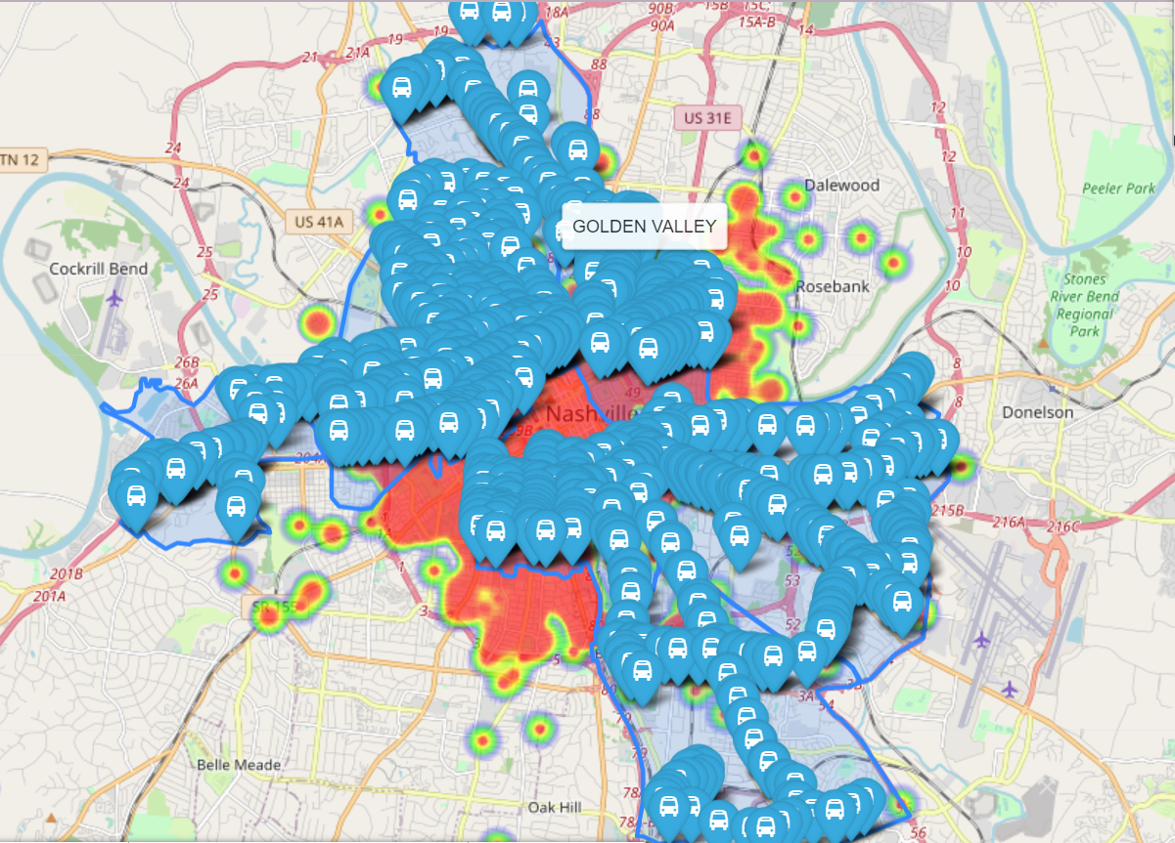
Mitigate Last Mile Challenges
Making sure the scooters are in the promise zones
Match scooter parking with bus stops
“Micromobility may be an important means of transportation in the Promise Zone to help mitigate the “last mile” problem that exists in connecting people where they live to public transportation.”
Notes:
Taryn

Slide 15
THANK You!!
Scooter Snatchers

